Slide 1
Facial Detection and Recognition on Raspberry Pi
Students :
Foley, Patricia
Volkmann, Landon
Yadav, Hari
Zakari, Abdulmuhaymin
Instructor: Sayed Khushal Shah

Slide 2
Topics Covered
Introduction
Brief History
Methods
Training
Demo
References

Slide 3
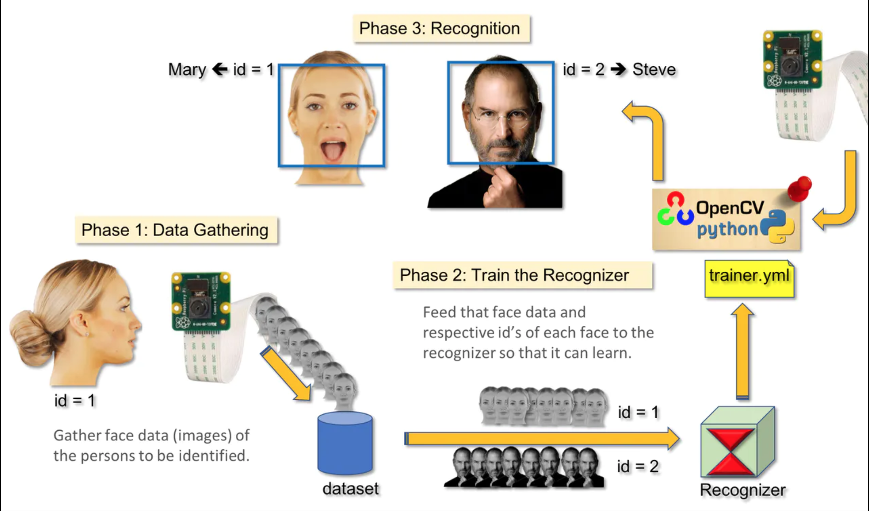
Introduction

Slide 4
Brief History
First developed mid-1960s
US intelligence agencies
Military
2017 outperformed human experts

Slide 5
What is Facial Detection?
Detect face or non-face
If there is a face, find location and size of each face.
Add classification of face or non-face.

Slide 6
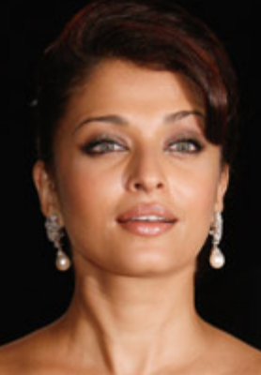

What is Face Recognition?
ID a detected face
Known – provide name
Unknown
Face Detection
Feature Extraction
Face Recognition

Slide 7
Difference Between Face Detection and Face Recognition
FD: only two classification
Face or non face
FR:
Multiple classes
One vs everyone else
Specific classes for everyone
Classification from face shape, eye, nose, mouth etc.
FR process requires the first FD

Slide 8
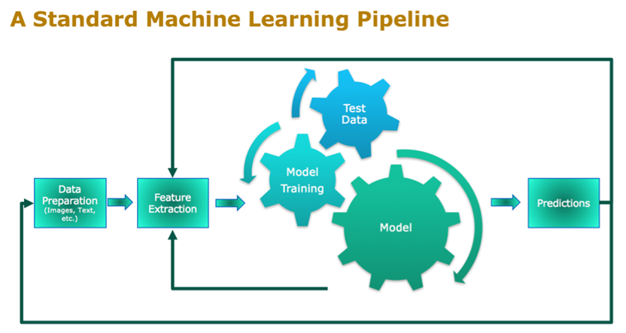
Training

Slide 9
Process from IOT Perspective
Initialize environment with motion detector and camera sensor
Detect motion
Capture image
Run facial detection, localization, and classification on image
Send email via python libraries smtplib + ssl to user email with prediction

Slide 10
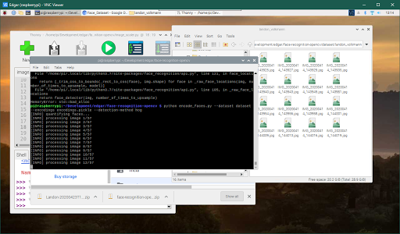
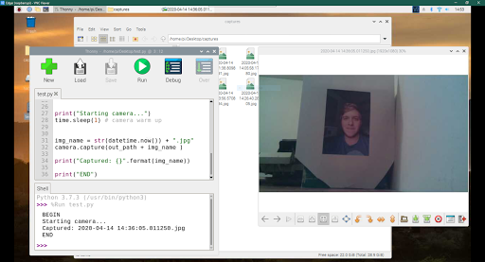
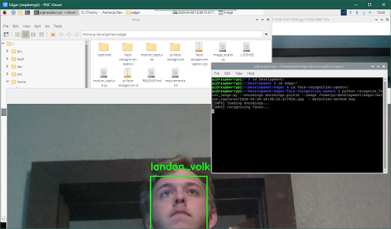
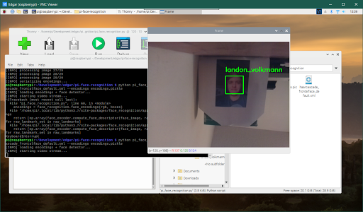
Demo

Slide 11


https://www.youtube.com/watch?v=eEptH_mVsG8&feature=youtu.be
Short link: https://bit.ly/2yvTegY

Slide 12
Conclusions
Benefits
Security Smart Home Applications
Data Collection Insights
Possible Future Advances
Integration with social media platforms to expand data set
Deploy a feedback loop via mobile application
Integration with smart lock

Slide 13
References:
https://www.slideshare.net/
https://www.pyimagesearch.com/2018/06/25/raspberry-pi-face-recognition/ https://www.pyimagesearch.com/2018/06/18/face-recognition-with-opencv-python-and-deep-learning/ https://www.pyimagesearch.com/2018/04/09/how-to-quickly
build-a-deep-learning-image-dataset/
https://www.hackster.io/mjrobot/real-time-face-recognition-an-end-to-end-project-a10826

